Slide 1

A MIP-based Approach to
Optimizing Course Scheduling at USC Marshall
DSO 570 Final Project – Spring 2018
Louis Yansaud | Jae Min Lee | Rachel Feldman | Shuxiao Zhou | Vishnu Kunchur

Slide 2

Agenda
01
Business Problem
02
Optimization
03
MIP Formulation
04
Results / Implementations
05
Conclusion

Slide 3
Business Problem

Slide 4
Current Scheduling Process
Phase 1
End of Phase 1
Phase 2
Each department head determines which courses to populate while satisfying the particular needs of each course. Instructors may also reach out to the department head to indicate preferences for teaching times.
Any unused time slots at from phase 1 become open for any USC Marshall department to use.
Using historical schedules, changes are made according to the initial allocation results of Phase 1. Shannon and Hal then schedule the remaining courses.
Notes:
Phase 1 is processed by department and with instructors within the department.
The department allocates the courses accordingly to the particular needs of each course and instructor’s preferences.
Shannon and Hal use the historical scheduling data to adjust the initial allocations made by each department.
And then schedule the remaining courses from the Phase 1.

Slide 5
Preferences
Preferences for classrooms and times become increasingly difficult to accommodate during Phase II as previously available slots become taken
Classroom Capacity
Some courses may be placed into rooms too large for the number of students enrolled in the course
Potential Challenges
Only about 40% of course-sections are completely scheduled by the end of Phase I and in some rare cases, the classroom may still be unassigned at registration time
Unassigned Classroom
Notes:
There are big 3 potential challenges to the current scheduling system.
Preferences - Preferences for classrooms and times become increasingly difficult to accommodate during Phase II as previously available slots become taken.
Classroom capacity - Some courses may be placed into the rooms that are too large for the number of students enrolled in the course.
Unassigned classrooms - Only about 40% of course-sections are completely scheduled by the end of Phase I and in some rare cases, the classroom may still be unassigned at registration time.

Slide 6
Optimization

Slide 7
WHY Optimization
Faster
Automatized computational method would make the process faster
Less Demanding
Manageable by fewer staff
More Efficient
Maximization of efficiency with Mixed Integer Linear Programming. Efficiency use of all available resources
Maximization of efficiency with Mixed Integer Linear Programming. Efficiency use of all available resources

Slide 8
HOW it works
Management Team
(Shannon & Hal)
Department preference scores data
(classroom-timeslots)
“Switching” algorithm
(Historical preference data + survey)

Slide 9




Application of MIP
Survey
Aggregated Preference Data
MIP Optimizer
Course Schedule
Management conducts a survey to learn preferences for classrooms and/or time-slots
A proprietary algorithm converts the input survey data into preference data for classroom-timeslot combinations
The MIP uses preference data to allocate candidate sets for each category of sections, for each department
Indicating whether a classroom session is assigned to a department on day

Slide 10
Caveat / Limitations
01
Different number of courses by each department
02
Additional Preferences by Professors
03
Possibility of same ‘black out’ time slots by each department
04
Classroom utilization not taken in account

Slide 11
MIP Formulation

Slide 12
Data Understanding
I
{D1,...,Di} is the set of 'i' Departments
P_{ijk}
The set of historical preference scores of a Department 'i' for a CS 'k' for day 'j
J
Day Patterns: {M, T, W, H, M-W, T-H , F}
J_{1.5 / 3}
{M,T,W,H,F}: subset of days where department 'i' is assigned a 1.5 unit course.
{M-W,T-H}: subsets of days where department 'i' is assigned a 3.0 unit course
K
{CS1,...,CSk} is the set of i Classroom Sessions Timeslots.
Input Data
Q
Minimum number of timeslot requirement by department ‘i’ for ‘Small’, ‘Medium’, and ‘Large’ sections and for 1.5 and 3.0 credit courses.
CS
{Small (S), Medium (M), Large (L)} is the set of Classroom Size types

Slide 13
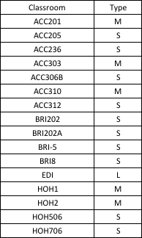
Data Understanding
From historical data, classroom can be classified into 3 different sizes:
Small: Classroom Size < 45
Medium: Classroom Size > 45 & < 75
Large: Classroom Size > 75
Input Data

Slide 14
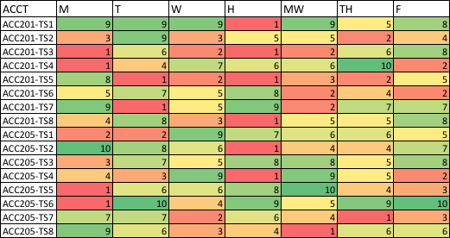
Data Understanding
Preference Score Survey are sent to each department head
Input Data

Slide 15
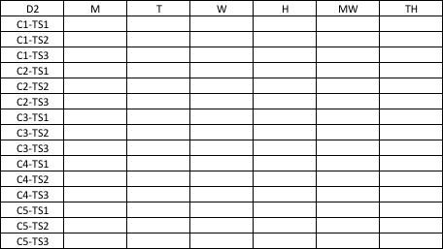
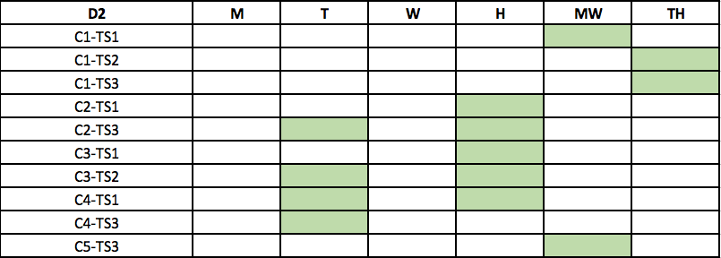
Data Understanding
X_{ijk}
Table Matrices of decision variables X_{ijk} indicating whether classroom session ‘k’ is assigned to department ‘i’ on day ‘j’
Output Data

Slide 16
MIP Formulation
Decision Variables
Tuning Variable
Auxiliary Variables
X_{ijk}
ƛ
U_{DP} L_{DP}
Whether the classroom session (CS) ‘k’ is allocated to a department 'i' on a day 'j’.
Total of 270 decision variables
(Binary)
Tuning parameter to scale the preference score inequality.
In this problem,
ƛ = 100.
U_{DP}: Maximum Weighted Cumulative Department Preference
L_{DP}: Minimum Weighted Cumulative Department Preference

Slide 17


MIP Formulation (Objective Function)
Maximize:
Sum of Preference scores
Fairness Factor
Sum of the preference score of each department for a given classroom session multiplied by the binary decision variable of whether they were assigned to a classroom session.
Aims to ensure that all departments are assigned a similar overall preference score v

Slide 18
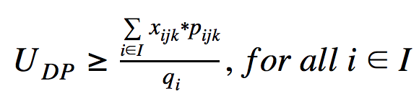


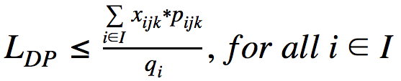



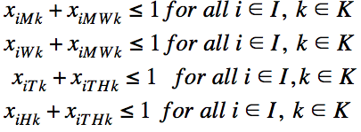

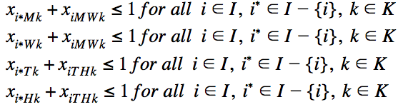

MIP Formulation (Constraints)
Upper Bound
Medium Session, 1.5 / 3.0 units requirements
Lower Bound
Large Session, 1.5 / 3.0 units requirements
One Department gets One Slot
Intra-Department Conflict
Small Session, 1.5 / 3.0 units requirements
Inter-Department Conflict

Slide 19






MIP Formulation (Constraints) - Cont.
Maximum Allocations, Small 1.5 Credits:
Maximum Allocations, Large 1.5 Credits:
Maximum Allocations, Small 3.0 Credits:
Maximum Allocations, Large 3.0 Credits:
Maximum Allocations, Medium 1.5 Credits:
Preference > Allotment
Maximum Allocations, Medium 3.0 Credits:

Slide 20
Results & Implementations

Slide 21
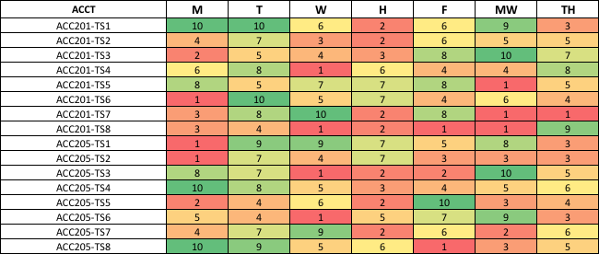

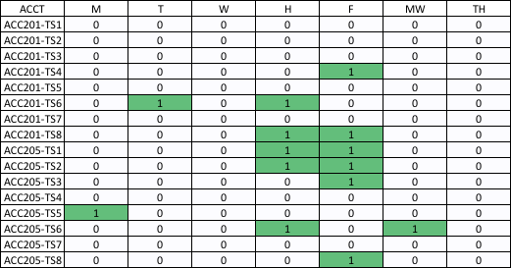
Results
Table 1. Candidate Input: Classroom Sessions by Department ACCT
Table 2. Candidate Output: Classroom Sessions allocated to Department ACCT
Notes:
This is the results of our MIP model which maximizes the cumulative department preference score while minimizing the department preference score inequalities. The first table is the candidate input which represents the classroom sessions preference score by the ACCT department. This table has different color scales depending on the preference score which ranges from 1 to 10 with 10 being the most preferable highlighted in green.
Table 2 represents the candidate output of our optimization model, which shows each of the decision variables for each department whether a classroom session is being allocated to a particular day.
For reference, we only show the first 16 decision variables as we can only fit so much in one slides, theres a total of 352 decision variables per department
7 department total at Marshall so it gives us a total of 2464 decision variables. More than 2000 decision variables

Slide 22

Implementation
Department
Classroom Session
Day
ACCT
ACC201 / 08:00:00 - 09:50:00
M, W, TH
BAEP
JFF 233 / 14:00:00 - 15:50:00
M, T, F
Preference Score Survey
MOR
JKP 110 / 10:00:00 - 11:50:00
MW, TH

Slide 23
Conclusion

Slide 24
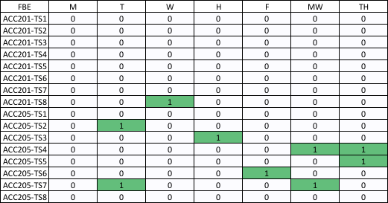
Why use this model?
Department Satisfaction
Takes classroom-time slot preference into account
01
Flexibility
Easy to implement parameter changes
02
Efficiency
Reduces manual labor time
03
Feasibility
Closely aligned with the current scheduling system
04

Slide 25
Day Pattern
- Allocate 3-unit classes in consecutive time-slots
Classroom Utilization
- Increase the number of categories for classroom size
- Building classroom category-specific MIP models.
Improvements
Notes:
Day pattern - 3-unit classes in consecutive time-slots Classroom utilization - We classified classroom size into small, medium and large. - This overlooks the exact classroom capacity which can lead to suboptimal allocations. - We can mitigate this either by increasing number of categories for classroom size or by building classroom category-specific MIP models.

Slide 26

Thank you
Any questions?

